Slide 1

AWS Machine Learning Specialty Certification Exam
What is Machine Learning — Wikipedia
“Machine learning (ML) is the scientific study of algorithms and statistical models that computer systems use to perform a specific task without using explicit instructions, relying on patterns and inference instead.”
It is seen as a subset of artificial intelligence.
Machine learning algorithms build a mathematical model based on sample data, known as "training data", in order to make predictions or decisions without being explicitly programmed to perform the task.
Machine learning algorithms are used in a wide variety of applications, such as email filtering and computer vision, where it is difficult or infeasible to develop a conventional algorithm for effectively performing the task.

Slide 2


Artificial Intelligence vs Machine Learning
Which are we talking about?
What is Artificial Intelligence?
“You have to talk about 'The Terminator' if you're talking about artificial intelligence. I actually think that that's way off. I don't think that an artificially intelligent system that has superhuman intelligence will be violent. I do think that it will disrupt our culture.” —Gray Scott
“I visualize a time when we will be to robots what dogs are to humans, and I’m rooting for the machines.” —Claude Shannon

Slide 3
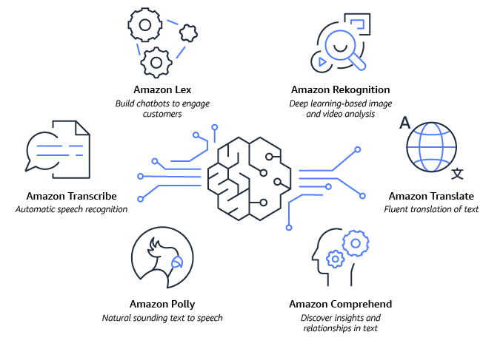
Artificial Intelligence on AWS
AWS Artificial Intelligence Services

Slide 4
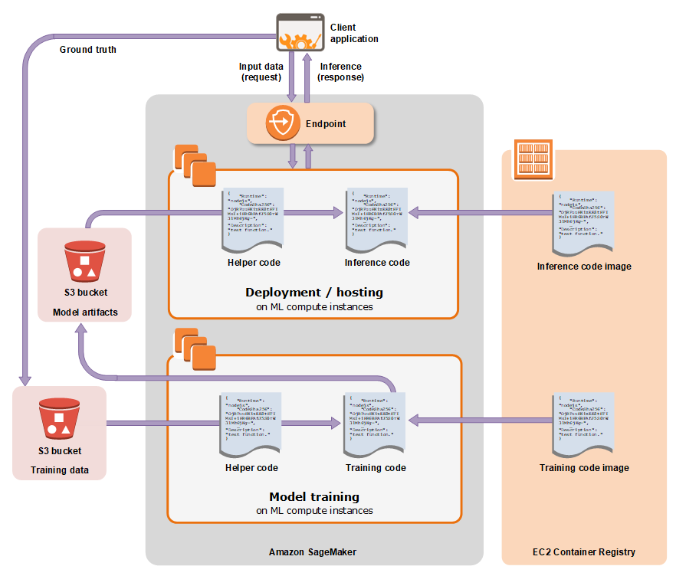
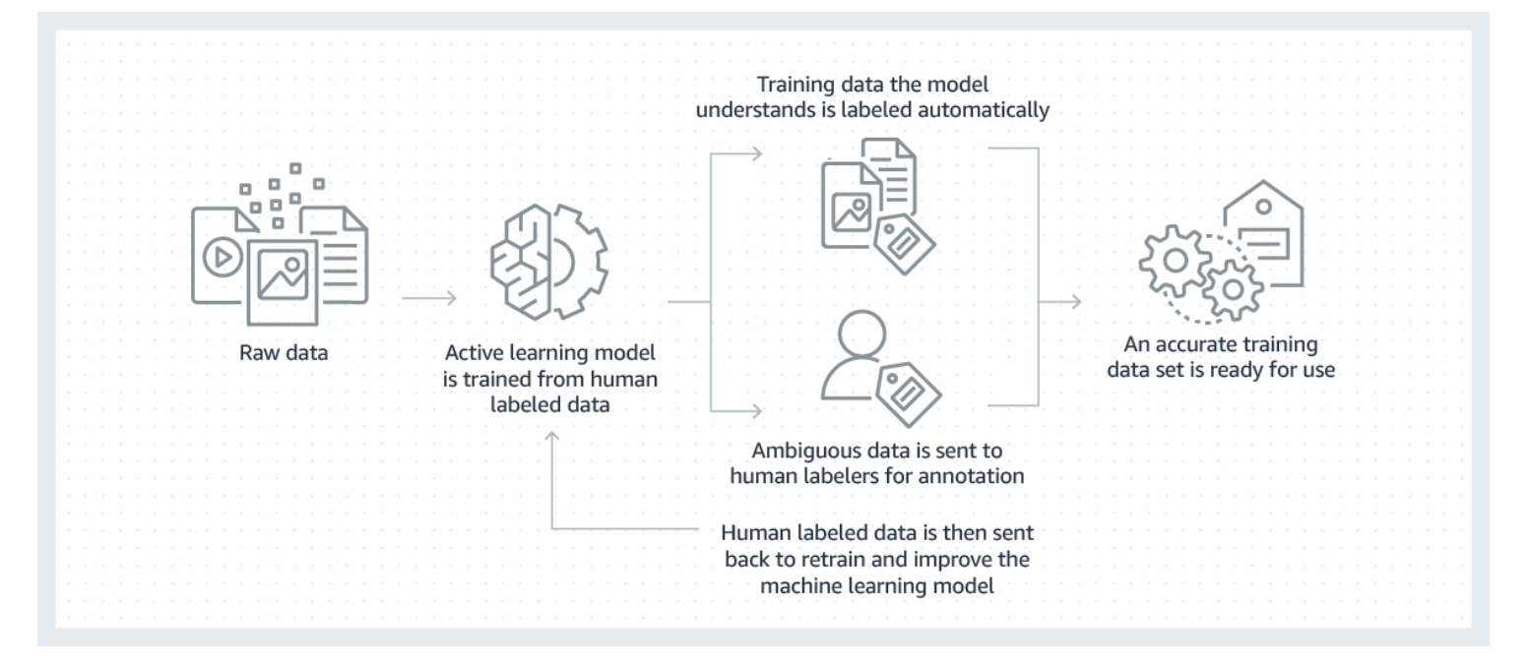
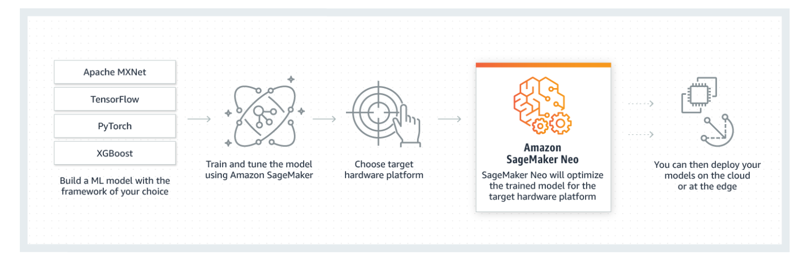
Machine Learning on AWS
AWS Machine Learning Services
Amazon SageMaker Ground Truth
Amazon SageMaker Neo

Slide 5
Machine Learning Demand
AWS Skills — CIO Magazine
Machine learning to remain most in-demand AI skill
Machine learning today is used for image identification and classification at scale, consumer-driven chatbots, NLP and voice search, lead prediction, and more advanced neural networks, like Google’s DeepMind network. The applications for and uses of machine learning are just now becoming realized, but employer demand for talent with ML skills has already risen dramatically.
Over the past three years alone the number of AI-related job postings on Indeed has increased by 119 percent, according to the platform’s latest AI talent report. The machine learning engineer role was cited as the third most in-demand AI job of the moment with machine learning ranked as the most in-demand AI skill. With AI projected to create 2.3 million jobs by 2020, according to a Gartner report, I think it’s safe to assume that machine learning will remain an in-demand skill for the foreseeable future.

Slide 6

Machine Learning Platform of Choice
AWS
Most widely used machine learning platform in the industry

Slide 7
AWS Machine Learning Specialty Certification Exam
Why Should You Take It?
The AWS Certified Machine Learning - Specialty certification is intended for individuals who perform a development or data science role. It validates a candidate's ability to design, implement, deploy, and maintain machine learning (ML) solutions for given business problems.
Abilities Validated by the Certification
Select and justify the appropriate ML approach for a given business problem
Identify appropriate AWS services to implement ML solutions
Design and implement scalable, cost-optimized, reliable, and secure ML solutions

